Slide 1
CMSC 471
Artificial Intelligence
Constraints
Many slides courtesy Tim Finin

Slide 2
Overview
Constraint satisfaction is a powerful problem- solving paradigm
Problem: set of variables to which we must assign values satisfying problem-specific constraints
Constraint programming, constraint satisfaction
problems (CSPs), constraint logic programming…
Algorithms for CSPs
Backtracking (systematic search)
Constraint propagation (k-consistency)
Variable and value ordering heuristics
Backjumping and dependency-directed backtracking

Slide 3
Some Core Terminology
(algebraic) variable is a symbol used to denote features of possible worlds
– If X is a variable, dom(X) is X’s domain (the values
X can take on)

Slide 4
Example: Variable
Let’s consider rolling a standard,
six-sided die
Let 𝑋_{𝑖} be the variable corresponding to the outcome of the ith role
Q: What is
dom(𝑋_{𝑖})?

Slide 5
Example: Variable
Let’s consider rolling a standard,
six-sided die
Let 𝑋_{𝑖} be the variable corresponding to the outcome of the ith role
Q: What is
dom(𝑋_{𝑖})?
A: dom(𝑋_{𝑖}) =
{1, 2, 3, 4, 5, 6}

Slide 6
Types of Variables
Discrete variables have finite or countable domains
Binary variables have two values in their domain
Boolean variables have two variables, TRUE and FALSE
Other examples?
Continuous have uncountably infinite domains
Example types?

Slide 7
Example: Variable
Let’s consider rolling a standard,
six-sided die
Let 𝑋_{𝑖} be the variable corresponding to the outcome of the ith role
Q: What is
dom(𝑋_{𝑖})?
Q: Is 𝑋_{𝑖} discrete
or continuous?
A: dom(𝑋_{𝑖}) =
{1, 2, 3, 4, 5, 6}

Slide 8
Example: Variable
Let’s consider rolling a standard,
six-sided die
Let 𝑋_{𝑖} be the variable corresponding to the outcome of the ith role
Q: What is
dom(𝑋_{𝑖})?
Q: Is 𝑋_{𝑖} discrete
or continuous?
A: dom(𝑋_{𝑖}) =
{1, 2, 3, 4, 5, 6}
A: Discrete

Slide 9
Variable Assignments
Given N variables 𝐗 = {𝑋₁, 𝑋₂, … , 𝑋_{𝑁}}
An assignment is a setting of a subset 𝑋′ of those variables
Total assignment: 𝑋′ = 𝑿
Partial assignment: 𝑋′ ≠ 𝑿
A possible world is a possible way the world (the real world or some imaginary world) could be

Slide 10
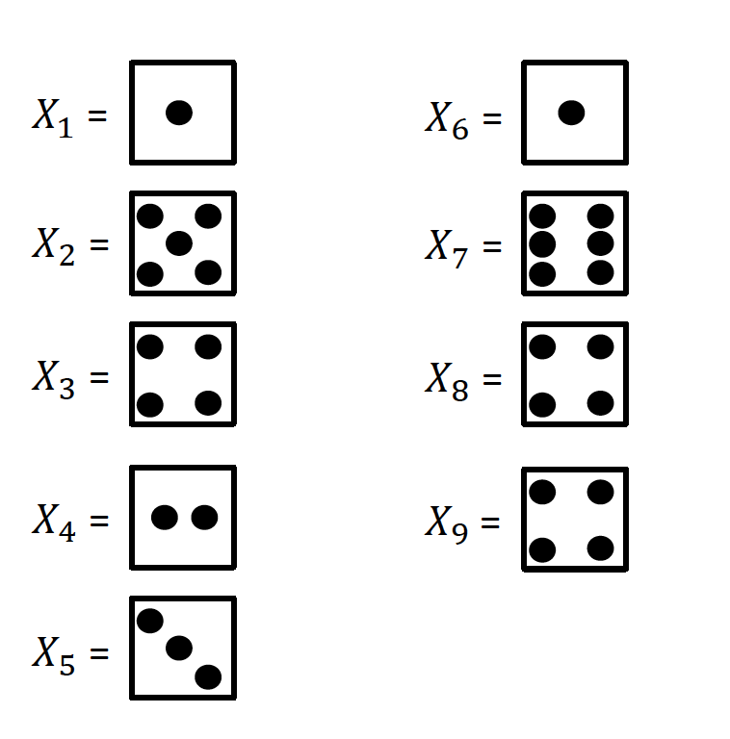
Full vs. Partial Assignment Example
Let’s say there are N=9 rolls of the same die
Full assignment Partial assignment

Slide 11
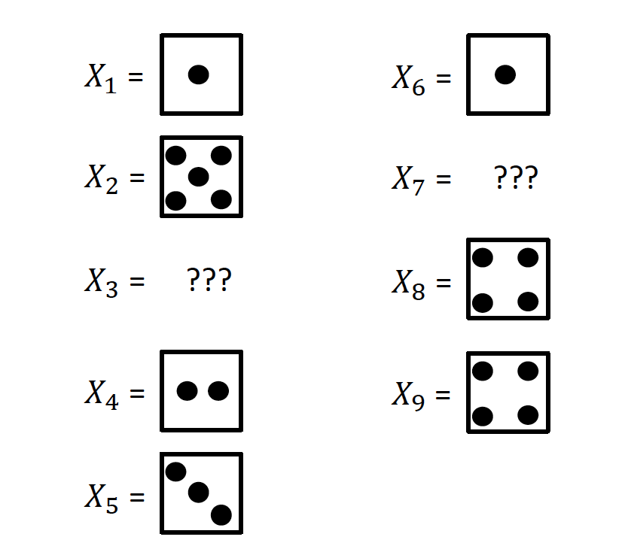
Full vs. Partial Assignment Example
Let’s say there are N=9 rolls of the same die
Full assignment Partial assignment

Slide 12
Thinking About Possible Worlds
Let’s say there are N variables. How many
possible worlds are there if:
Each variable’s domain is of size 2?
Each variable’s domain is of size 10?
Each variable’s domain is uncountably infinite
(the real numbers)?

Slide 13
Rethinking Problem Space
Reasoning explicitly in terms of states
How do you define relation between components (features) in a state?
Typically, better to describe states in terms of features
reason in terms of these features
Features are described using variables.
Features are not independent and there are hard constraints

Slide 14
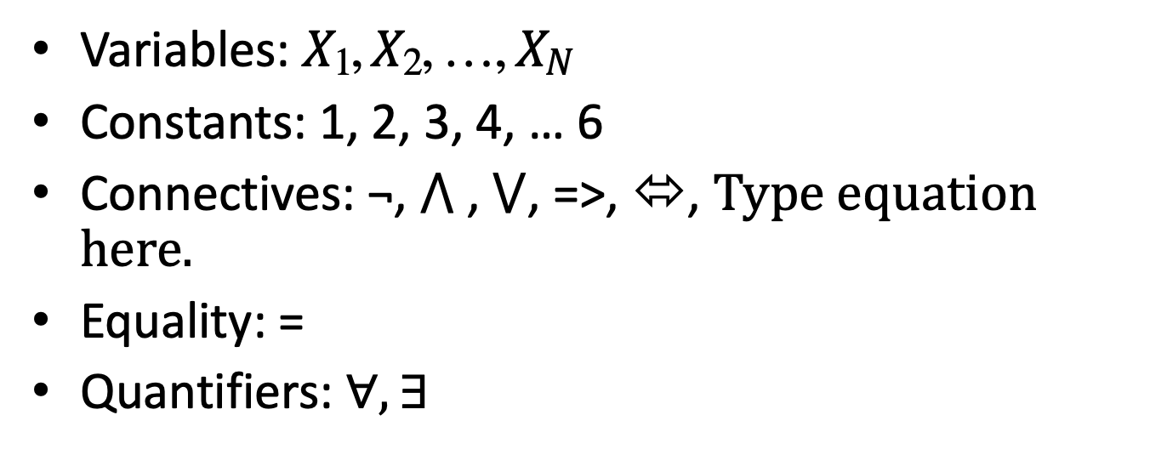
First-Order Logic (FOL)
Variables: 𝑋₁, 𝑋₂, … , 𝑋_{𝑁}
Constants: 1, 2, 3, 4, … 6
Connectives: ¬, ⋀ , ⋁, =>, ⬄,
Equality: =
Quantifiers: $∀, ∃$

Slide 15
First-Order Logic (FOL)
¬ means ‘not’
⋀ means ‘and’
⋁ means ‘or’
R1 = A ⋀ B means A ‘and’ B R1 = true
A = ?
B = ?
R2 = A ⋁ B means A ‘or’ B R2 = true
A = ?
B = ?
R3 = A ⋀ B ⋀ ¬C means A ‘and’ B ‘and’ ‘not’ C R3 = true
A = ?
B = ?
C= ?

Slide 16
Constraints
Many possible worlds… but are all of those possible worlds “possible?”
Constraint: a specification of allowed / disallowed combinations of assignments to individual variables
Scope: the set of variables involved in the constraint
Relation: Boolean function on the scope that indicates if the constraint is satisfied

Slide 17
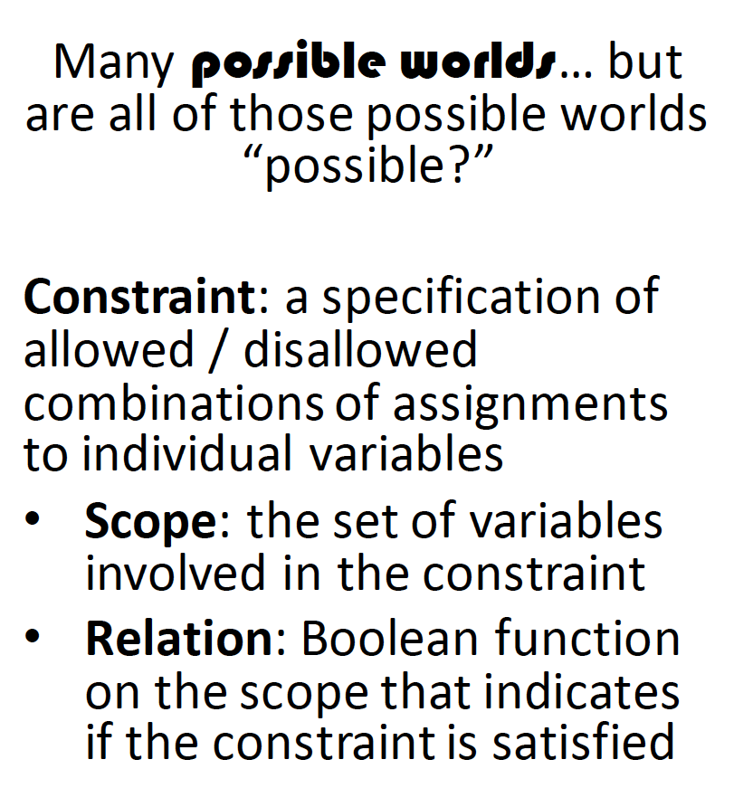
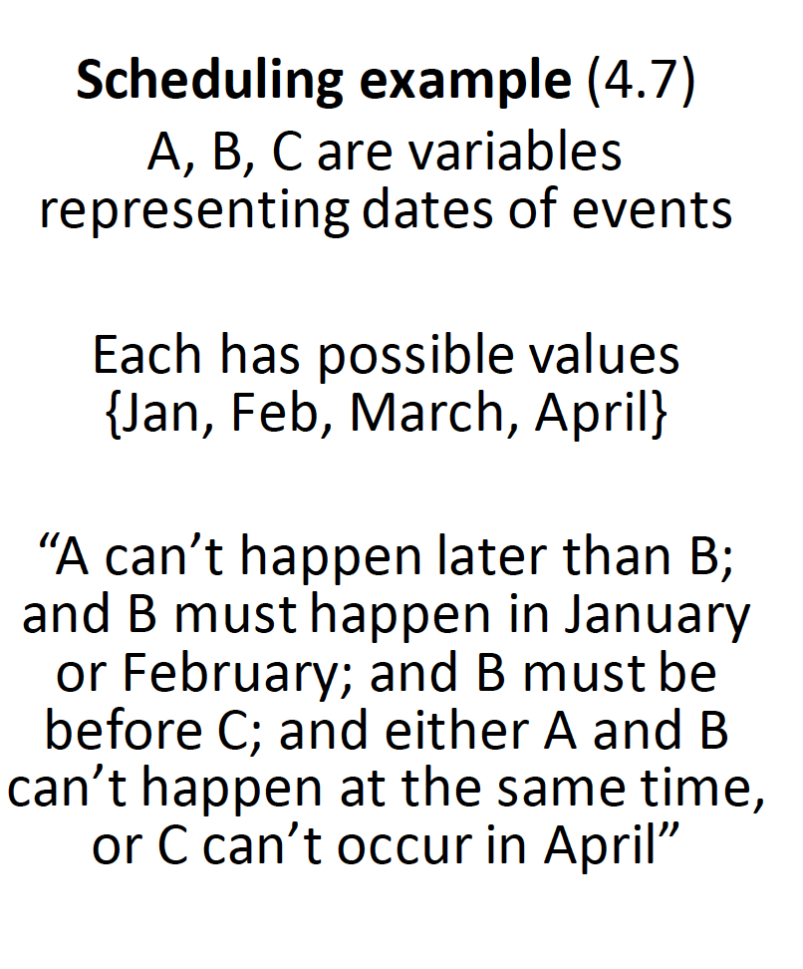
Constraints

Slide 18
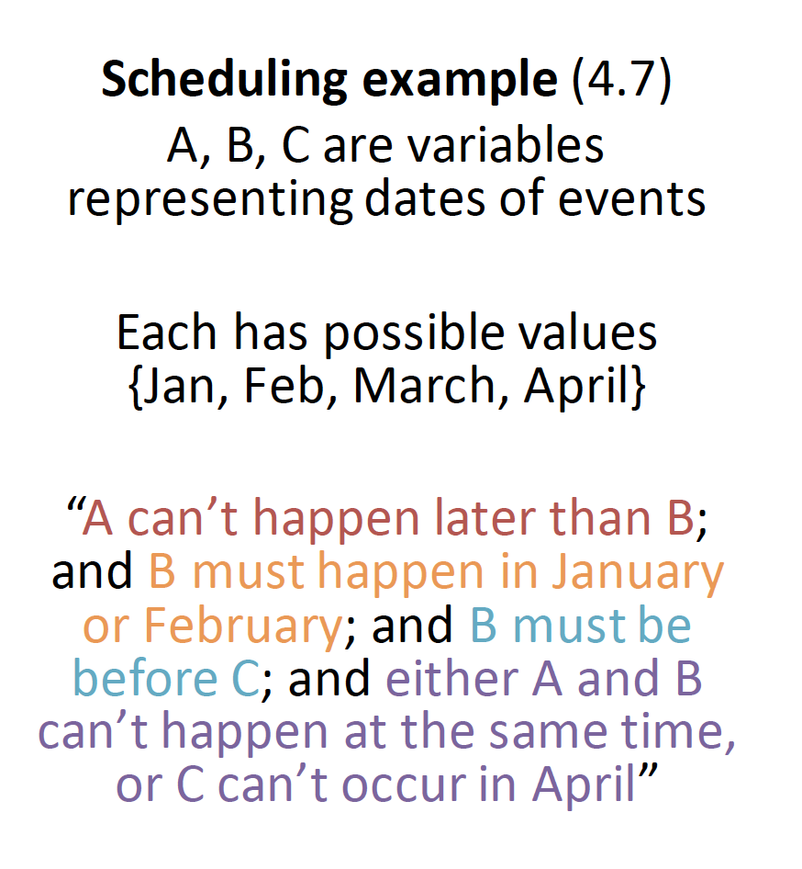
Constraints

Slide 19
Constraints
𝐴 ≤ 𝐵 ∧
𝐵 < March ∧
𝐵 < 𝐶 ∧
𝐴 ≠ 𝐵 ∨ 𝐶 < April

Slide 20
Constraints
Many possible worlds… but are all of those possible worlds “possible?”
Scheduling example (4.7)
A, B, C are variables representing dates of events
Constraint: a specification of allowed
/ disallowed combinations of assignments to individual variables
Each has possible values
{Jan, Feb, March, April}
Scope: the set of variables involved in the constraint
Relation: Boolean function on the scope that indicates if the constraint is satisfied
“A can’t happen later than B; and B must happen in January or February; and B must be before C; and either A and B can’t happen at the same
time, or C can’t occur in April”
𝐴 ≤ 𝐵 ∧
𝐵 < March ∧
𝐵 < 𝐶 ∧
𝐴 ≠ 𝐵 ∨ 𝐶 < April
Scope ({A, B})

Slide 21
Constraints
Many possible worlds… but are all of those possible worlds “possible?”
Scheduling example (4.7)
A, B, C are variables representing dates of events
Constraint: a specification of allowed
/ disallowed combinations of assignments to individual variables
Each has possible values
{Jan, Feb, March, April}
Scope: the set of variables involved in the constraint
Relation: Boolean function on the scope that indicates if the constraint is satisfied
“A can’t happen later than B; and B must happen in January or February; and B must be before C; and either A and B can’t happen at the same
time, or C can’t occur in April”
𝐴 ≤ 𝐵 ∧
𝐵 < March ∧
𝐵 < 𝐶 ∧
𝐴 ≠ 𝐵 ∨ 𝐶 < April
Scope ({A, B})
Relation (≤)

Slide 22
Constraints
Many possible worlds… but are all of those possible worlds “possible?”
Constraint: a specification of allowed / disallowed combinations of assignments to individual variables
Scope: the set of variables involved in the constraint
Relation: Boolean function on the scope that indicates if the constraint is satisfied
Constraints are satisfied (an assignment that makes all constraints TRUE) or violated
Slide

Slide 23
Motivating example: 8 Queens
Place 8 queens on a chess board such That none is attacking another.
Generate-and-test, with no redundancies ➔ “only” 8⁸ combinations
8**8 is 16,777,216
24

Slide 24
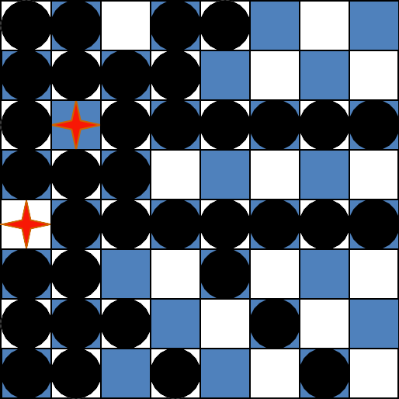
Motivating example: 8-Queens
After placing these two queens, it’s trivial to mark the squares we can no longer use
25

Slide 25
What more do we need for 8 queens?
Not just a successor function and goal test
But also
a means to propagate constraints imposed by one queen on others
an early failure test
➔ Explicit representation of constraints and constraint manipulation algorithms

Slide 26
Informal definition of CSP
CSP (Constraint Satisfaction Problem), given
finite set of variables
each with domain of possible values (often finite)
set of constraints limiting values variables can take
Solution: assignment of a value to each variable such that all constraints are satisfied
Possible tasks: decide if solution exists, find a solution, find all solutions, find best solution according to some metric (objective function)

Slide 27
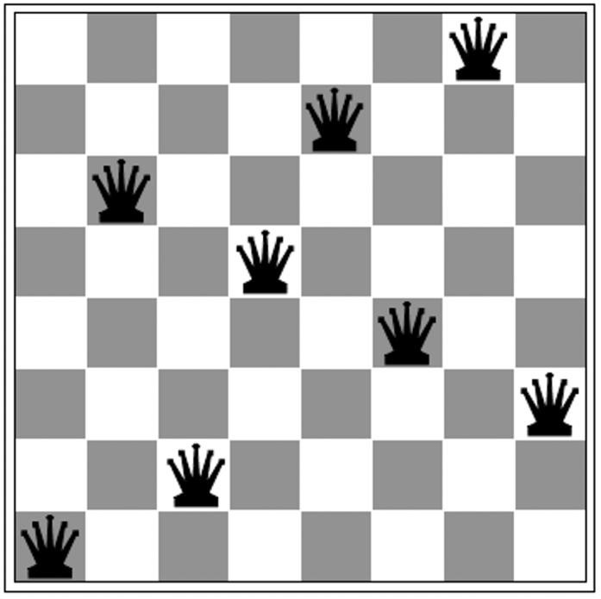
Example: 8-Queens Problem
What are the variables?
What are the variables domains, i.e., sets of possible values
What are the constraints between (pairs of) variables?

Slide 28
Example: 8-Queens Problem
Eight variables Qi, i = 1..8 where Qi is the row number of queen in column i
Domain for each variable {1,2,…,8}
Constraints are of the forms:
–No queens on same row
Qi = k ➔ Qj ≠ k for j = 1..8, j≠i
–No queens on same diagonal
Qi=rowi, Qj=rowj ➔|i-j|≠|rowi-rowj| for j = 1..8, j≠i

Slide 29
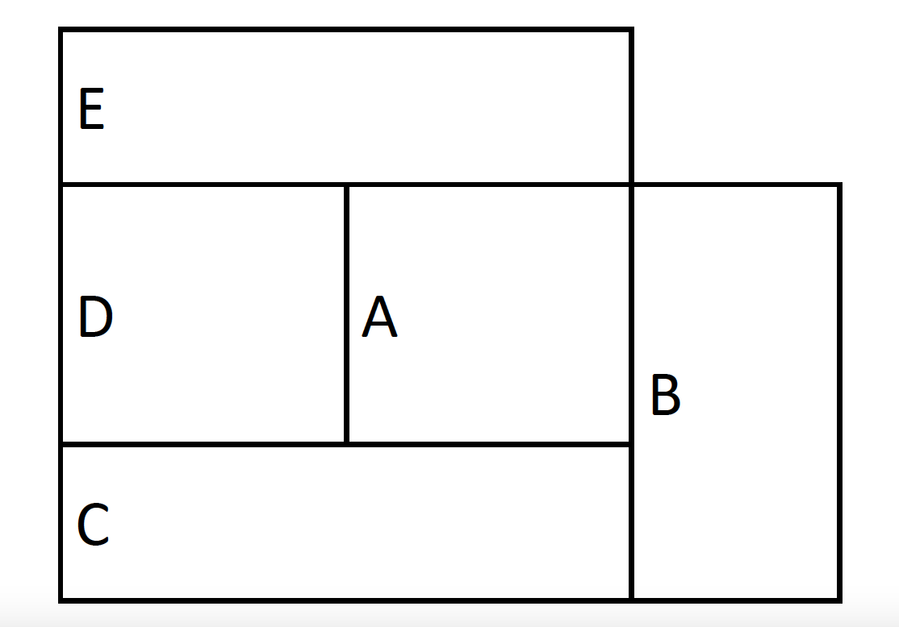
Example: Map coloring
Color this map using three colors (red, green, blue) such that no two adjacent regions have the same color

Slide 30
Map coloring
Variables: A, B, C, D, E all of domain RGB
Domains: RGB = {red, green, blue}
Constraints: A≠B, A≠C, A≠E, A≠D, B≠C, C≠D, D≠E
A solution: A=red, B=green, C=blue, D=green, E=blue
E
D | A | B
C
E
D | A | B
C
=>

Slide 31
Example: SATisfiability
Given a set of logic propositions containing variables, find an assignment of the variables to {false, true} that satisfies them
For example, the two clauses:
(A ∨ B ∨ ¬C)
( ¬A ∨ D)
are both made true (i.e. satisfied) by assigning
A = false, B = true, C = false, D = false
Satisfiability known to be NP-complete
⇒ worst case, solving CSP problems requires exponential time
Slide

Slide 32
Real-world problems
CSPs are a good match for many practical problems that arise in the real world
Scheduling
Temporal reasoning
Building design
Planning
Optimization/satisfaction
Vision
Graph layout
Network management
Natural language
processing
Molecular biology / genomics
VLSI design
34

Slide 33
Definition of a constraint network (CN)
A constraint network (CN) consists of
Set of variables X = {x₁, x₂, … x_{n}}
–with associate domains {d₁,d₂,…d_{n}}
–domains are typically finite
Set of constraints {c₁, c₂ … c_{m}} where
–each defines a predicate that is a relation over a particular subset of variables (X)
–e.g., C_{i} involves variables {X_{i1}, X_{i2}, … X_{ik}} and defines the relation R_{i} ⊆ D_{i1} x D_{i2} x … D_{ik}

Slide 34

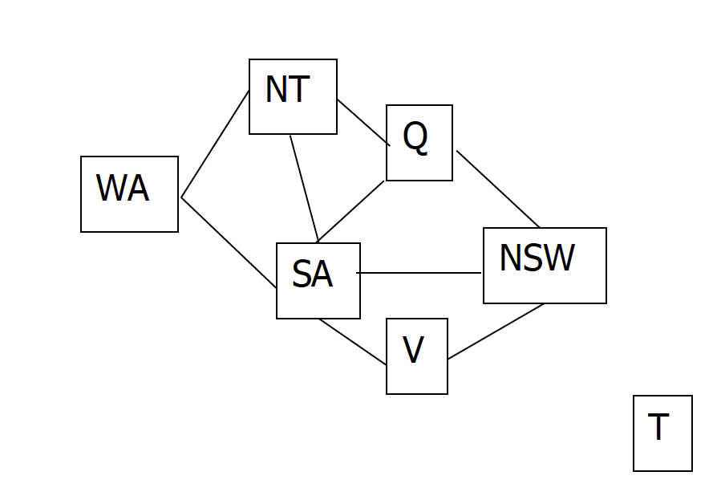
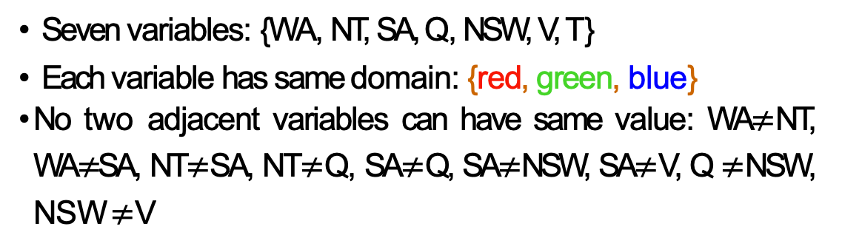
Running example: coloring Australia
Seven variables: {WA, NT, SA, Q, NSW, V, T}
Each variable has same domain: {red, green, blue}
No two adjacent variables can have same value: WA$≠$NT, WA$≠$SA, NT$≠$SA, NT$≠$Q, SA$≠$Q, SA$≠$NSW, SA$≠$V, Q $≠$NSW, NSW $≠$V
Slide

Slide 35
Unary & binary constraints most common
NT
Q
WA
SA
NSW
V
T
Two variables are adjacent or neighbors if
connected by an edge or an arc
Possible to rewrite problems with higher-order
constraints as ones with just binary constraints

Slide 36
Formal definition of a CN
Instantiations
An instantiation of a subset of variables S is an assignment of a value (in its domain) to each variable in S
An instantiation is legal iff it violates no constraints
A solution is a legal instantiation of all variables in the network

Slide 37
Typical tasks for CSP
Possible solution related tasks:
Does a solution exist?
Find one solution
Find all solutions
Given a metric on solutions, find best one
Given a partial instantiation, do any of above
Transform the constraint network into an
equivalent one that’s easier to solve

Slide 38
Binary CSP
A binary CSP is one where all constraints involve two variables (or just one variable)
Any non-binary CSP can be converted into a binary CSP by introducing additional variables
Binary CSPs represented as a constraint graph, with a node for each variable and an arc between two nodes iff there’s a constraint involving them
Unary constraints appear as self-referential arcs

Slide 39
Brute Force methods
Finding a solution by a brute force search is easy
Generate and test is a weak method
Just generate potential combinations
and test each
Potentially very inefficient
–With n variables where each can have one of 3 values, there are 3^{n} possible solutions to check
There are ~190 countries in the world, which we can color using four colors
4¹⁹⁰ is a big number!
solve(A,B,C,D,E) :-
color(A),
color(B),
color(C),
color(D),
color(E),
not(A=B),
not(A=B),
not(B=C),
not(A=C),
not(C=D),
not(A=E),
not(C=D).
generate
test
color(red). color(green). color(blue).
4**190 is 2462625387274654950767440006258975862817483704404090416746768337765357610718575663213391640930307227550414249394176L

Slide 40
Running example: coloring Australia
Seven variables: {WA, NT, SA, Q, NSW, V, T}
Each variable has same domain: {red, green, blue}
No two adjacent variables can have same value: WA$≠$NT, WA$≠$SA, NT$≠$SA, NT$≠$Q, SA$≠$Q, SA$≠$NSW, SA$≠$V, Q $≠$NSW, NSW $≠$V
Slide

Slide 41
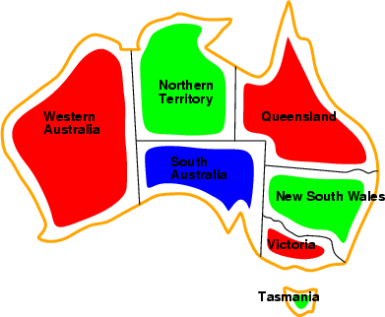
Running example: coloring Australia
NT
Q
WA
SA
NSW
V
T
Solutions: complete & consistent assignments
Here is one of several solutions
For generality, constraints can be expressed as relations, e.g., describe WA ≠ NT as
{(red,green), (red,blue), (green,red), (green,blue), (blue,red),(blue,green)}

Slide 42

Backtracking example

Slide 43
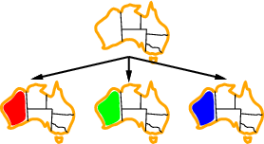
Backtracking example

Slide 44
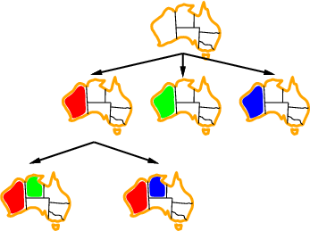
Backtracking example

Slide 45
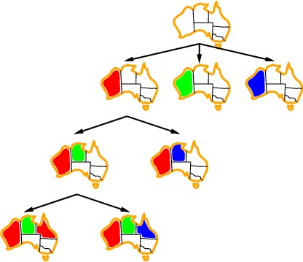
Backtracking example

Slide 46
Basic backtracking algorithm
CSP-backtracking(PartialAssignment a)
If a is complete then return a
X ← select an unassigned variable
D ← select an ordering for the domain of X
For each value v in D do
If v consistent with a then
Add (X=v) to a
result ← CSP-BACKTRACKING(a)
If result ≠ failure then return result
Remove (X= v) from a
Return failure
Start with CSP-BACKTRACKING({})
Note: depth first search; can solve n-queens problems for n ~ 25

Slide 47
Problems with Backtracking
Thrashing: keep repeating the same failed variable assignments
Things that can help avoid this:
–Consistency checking
–Intelligent backtracking schemes
Inefficiency: can explore areas of the search
space that aren’t likely to succeed
–Variable ordering can help

Slide 48
Improving backtracking efficiency
Here are some standard techniques to improve the efficiency of backtracking
Can we detect inevitable failure early?
Which variable should be assigned next?
In what order should its values be tried?

